Slide 1
Answer To Problem Task 2
Submitted by: Kshitij Tiwari
1

Slide 2
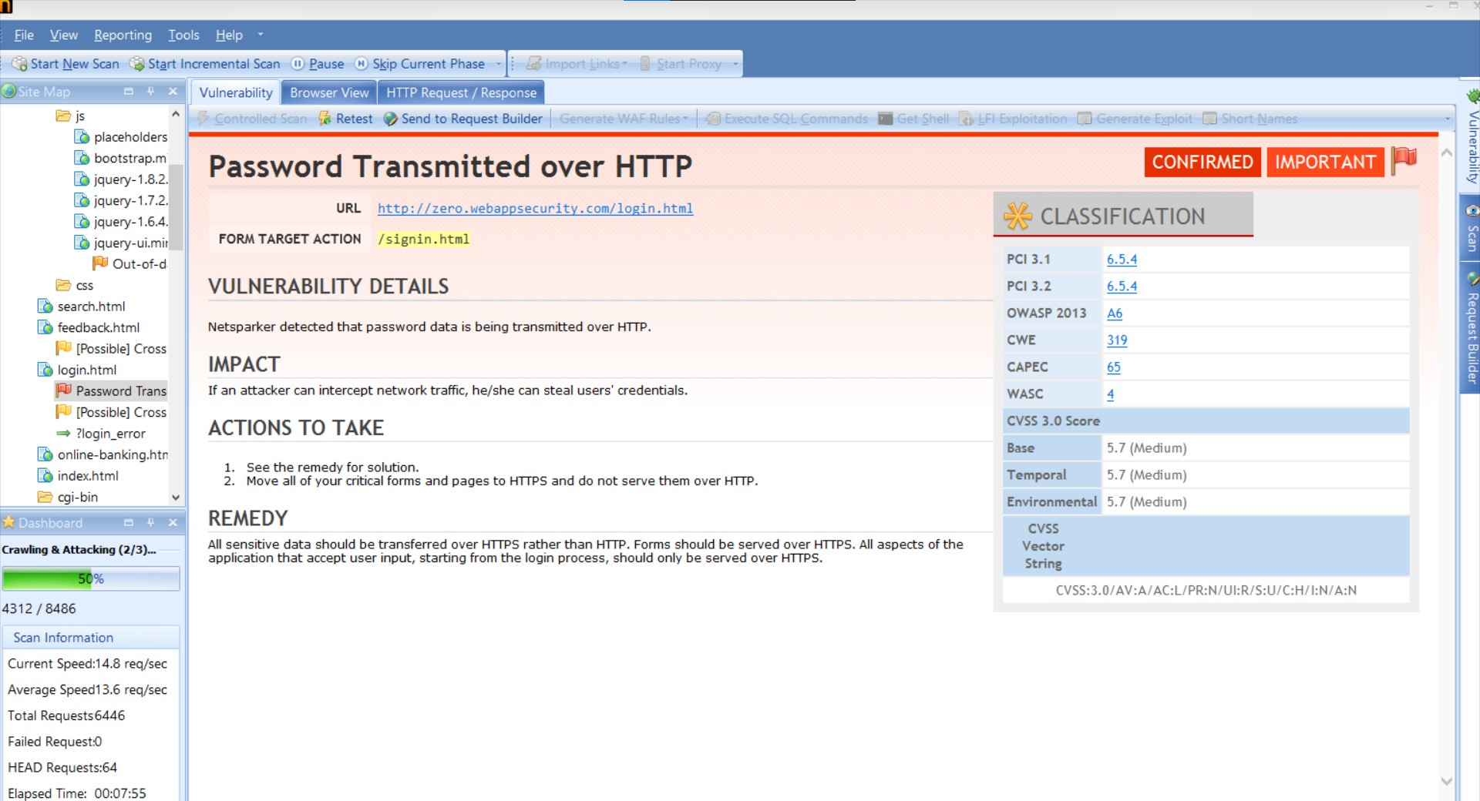
First Vulnerability

Slide 3
Report for first vulnerability

